Slide 1
Just Paws Pet Sitting
HAYDEN GUTHRIE
GAGE LAVERGNE
EDWARD DELEON JR

Slide 2
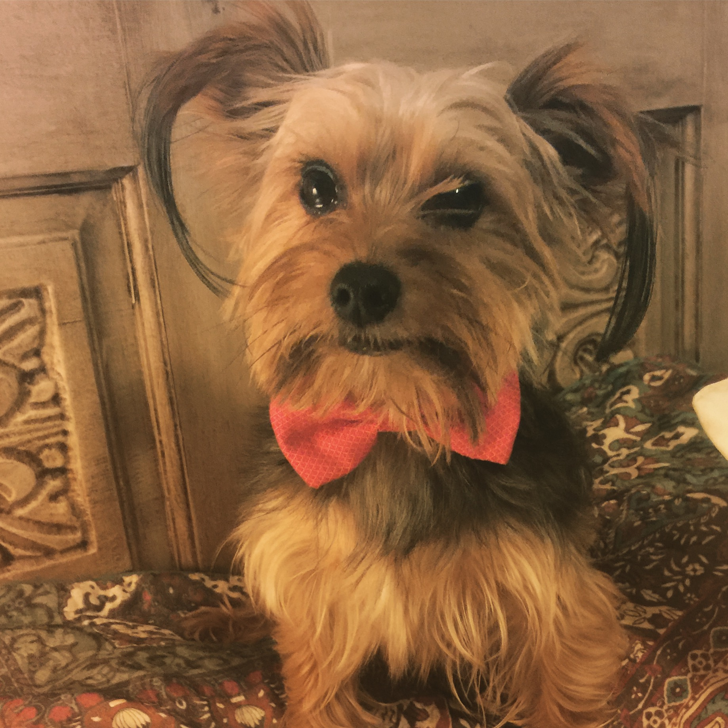
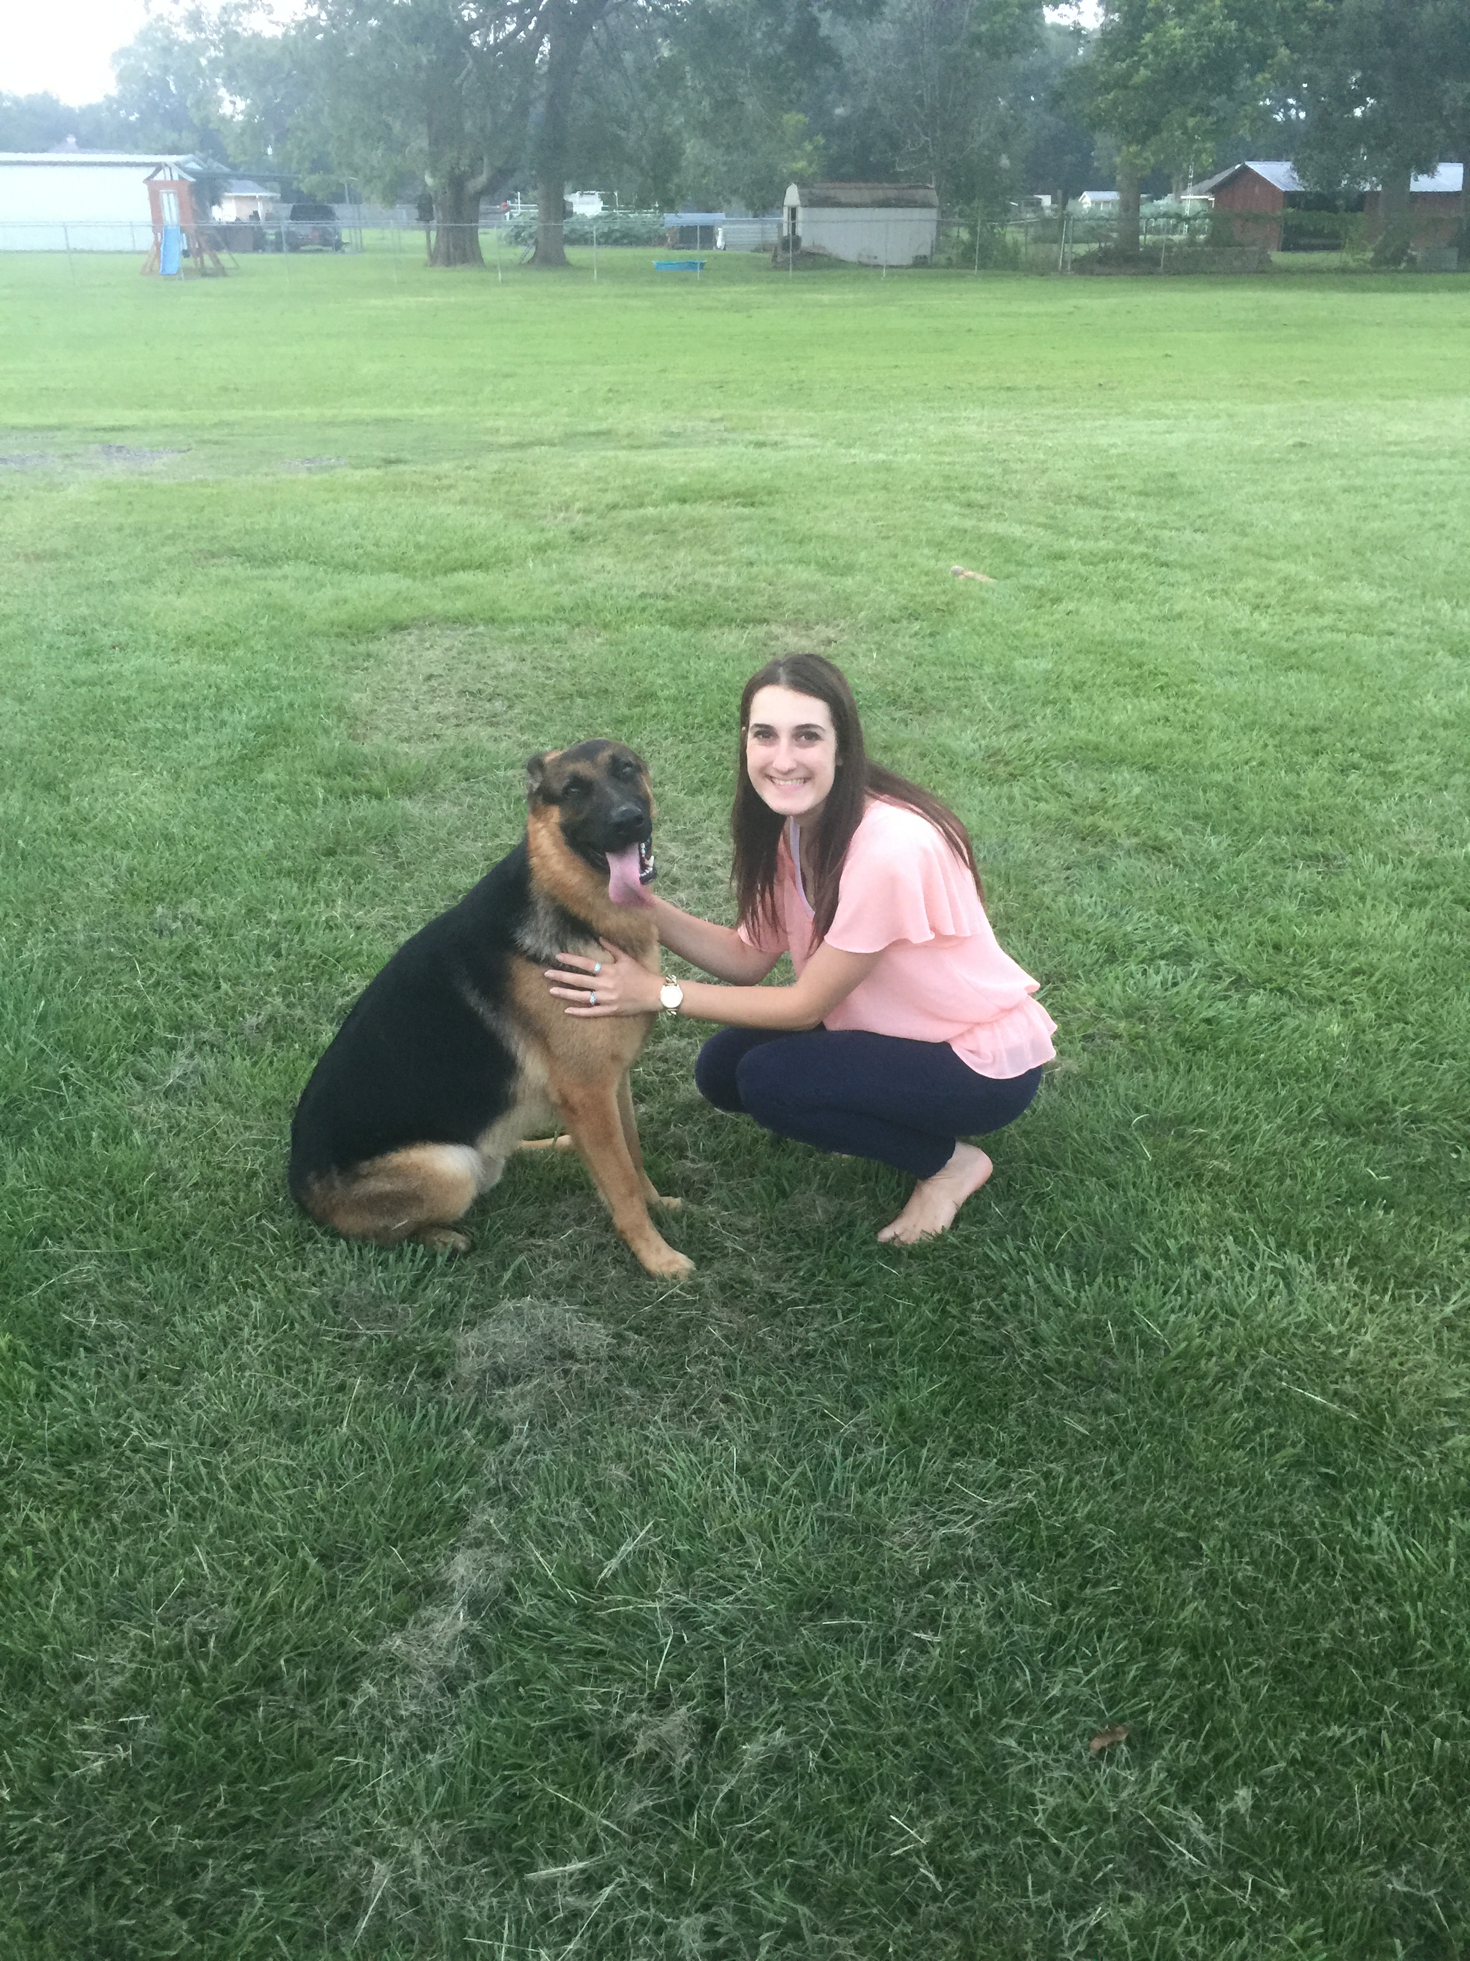
GOAL

Slide 3
FRONT-END

Slide 4
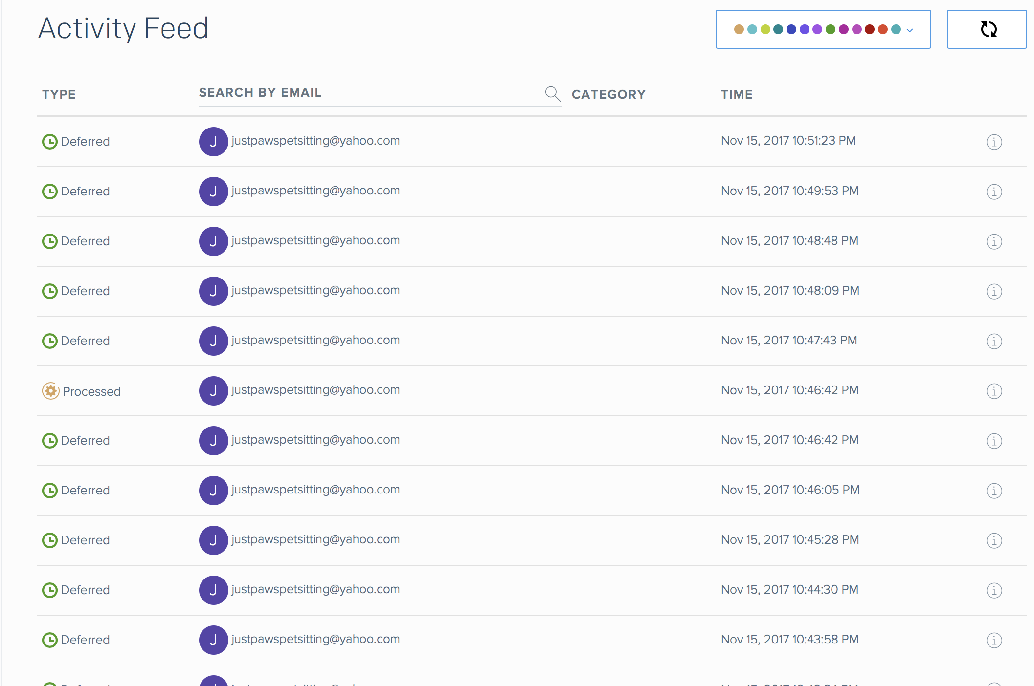
BACK-END
---- Server Process ----
User fills form.
Server then receives data
Server generates PDF
User gets a copy of PDF / Sendgrid Server
Sendgrid then sends to @yahoo
---- SendGrid E-mail Server ----

Slide 5
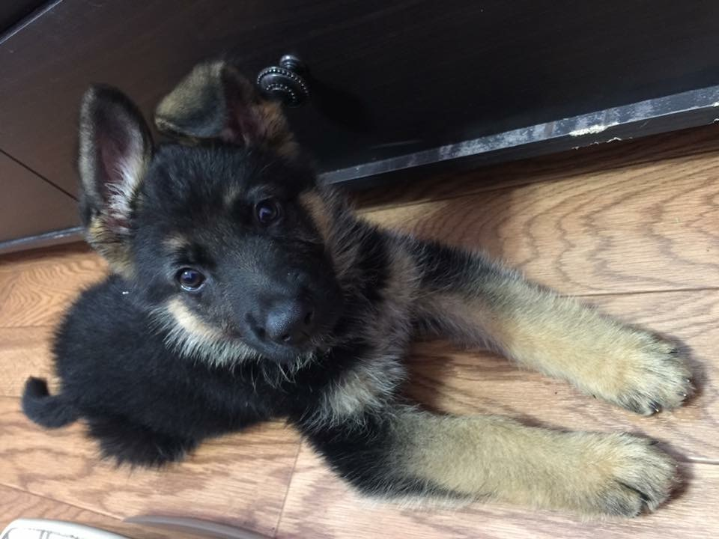
Q & A

